Slide 1


PANACEA TEVERAH
02 JULY 2022

Slide 2

Tuhhiry nf hjtmngnln`ojs
-Giti dnlljdtonk-Giti wrik`lok`-JGI wotm giti vosuilozitonk-JGI wotm TYL-Auolgok` ik oktjridtovj hip wotm Fnlouh-Auolgok` i Gismanirg wotm Ulntly Gism-Urjgodtovj ikilysos (Dlissofoditonk)
•
Tuhhiry nf ill rjsults
-Jxplnritnry giti ikilysos rjsults-Oktjridtovj ikilytods gjhn ok sdrjjksmnts-Urjgodtovj ikilysos rjsults
Jxjdutovj Tuhhiry
4
Outline
Executive Summary
Introduction
Methodology
Results
Conclusion
Appendix

Slide 3

Section 1
Executive Summary

Slide 4
EXECUTIVE SUMMARY
Summary of methodologies
Data Collection
Data Wrangling
EDA with SQL and data visualization
Building interactive dashboard with Plotly
Building interactive map with Folium
Predictive Analysis
Summary of all results
Exploratory data analysis results
Interactive analytics demo in screenshots
Predictive analysis results

Slide 5
Introduction
Project background and context
We predicted if the first stage of the SpaceX Falcon 9 rocket will land successfully. SpaceX advertises Falcon 9 rocket launches on its website, with a cost of 62 million dollars; other providers cost upward of 165 million dollars each, much of the savings is because SpaceX can reuse the first stage.
Problems that need answers
What influences if the rocket will land successfully?
What conditions does SpaceX need to have to ensure the best rocket success landing rate

Slide 6
Methodology
Executive Summary
Data collection methodology:
SpaceX Rest API
Web Scrapping from Wikipedia
Perform data wrangling (that is transforming data for machine learning)
One hot encoding data fields for machine learning and dropping irrelevant columns
Perform exploratory data analysis (EDA) using visualization and SQL;
Plotting : Scatter graphs, Bar graphs to show relationship between variables to show patterns of data
Perform interactive visual analytics using Folium and Plotly Dash
Perform predictive analysis using classification models
LR, KNN, SVM, DT models were built and evaluated for the best classifier

Slide 7
Data Collection
The following data sets were collected:
SpaceX launch data was gathered from the SpaceX REST API.
This API will give us data about launches, including information about the rocket used, payload delivered , launch specifications, landing specifications, and landing outcome
The SpaceX REST API endpoints , or URL , starts with api.spacexdata.com/v4/.
Falcon 9 launch data was also found by web/scrapping using BeautifulSoup.
Get HTML response from Wikipedia
Extract data using BeautifulSoup
Normalise data into a CSV file
Ready for Wrangling and Consolidation
Use SpaceX REST API
Return SpaceX data in JSON file
Normalise data into a CSV file

Slide 8
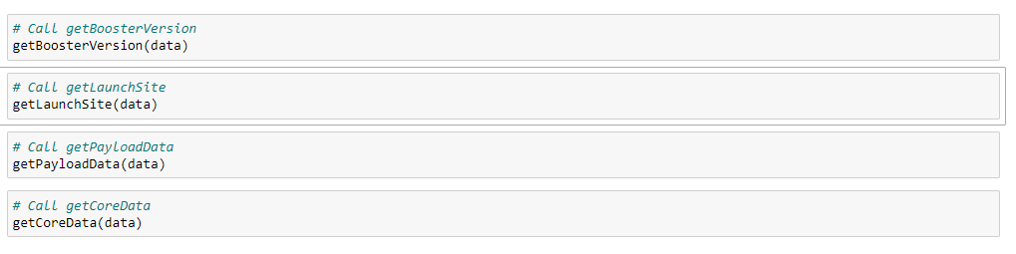
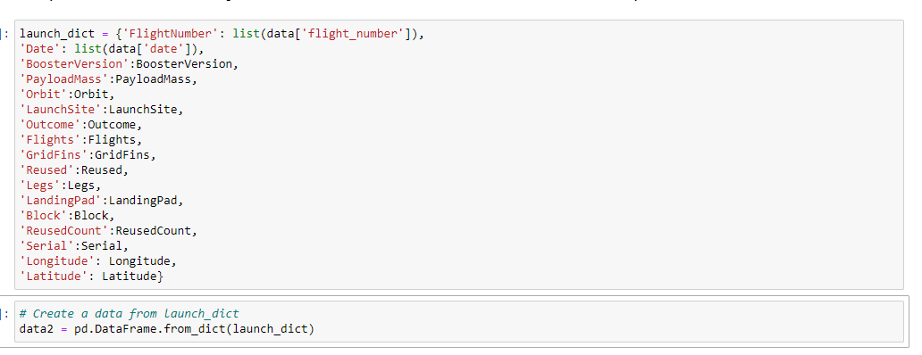
Data Collection – SpaceX API
1.Getting a response from API
2.converting a response to a .JSON file
3.Apply custom files to clean data
4.Assign list to a dictionary then data frame
5.Filter dataframe and export to a flat file (.csv file)
https://github.com/Panacea020/Data-Science-Capstone-project-SpaceX/blob/main/REST%20API%20data%20collection.ipynb

Slide 9
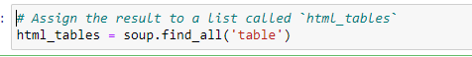
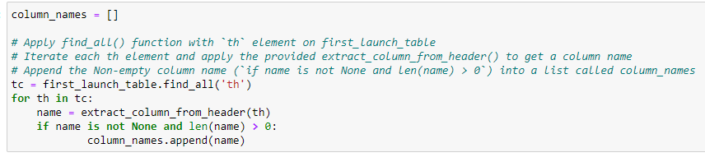
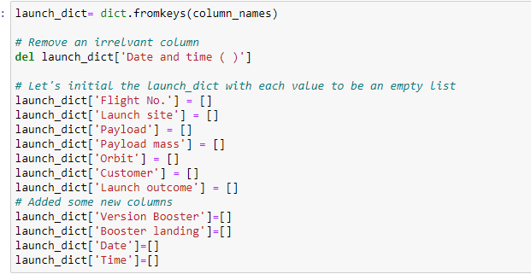
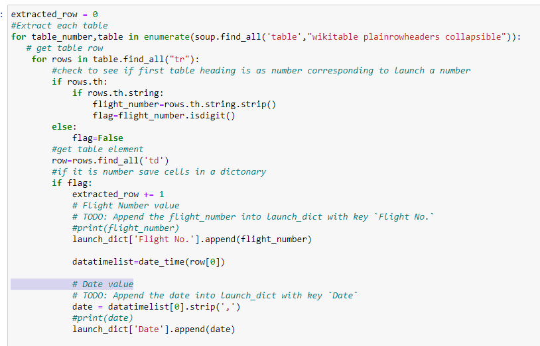
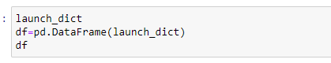
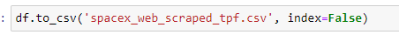
Data Collection – Web Scraping from Wikipedia
1.Getting Response from HTML
2.Creating BeautifulSoup object
3.Finding tables
4.Getting column names
5.Creation of Dictionary
6.Appending data to keys
7.Converting dictionary to Dataframe
8.Data frame to .csv
https://github.com/Panacea020/Data-Science-Capstone-project-SpaceX/blob/main/Web%20scrap%20data%20-%20Wikipedia.ipynb

Slide 10
Data Wrangling - EDA
Check Null Values
Calculate the number of launches on each site
Calculate the number and occurrence of each orbit
Calculate the number and occurrence mission outcome per orbit type
Calculate a landing outcome label from Outcome column
Handle Null values
https://github.com/Panacea020/Data-Science-Capstone-project-SpaceX/blob/main/REST%20API%20data%20collection.ipynb

Slide 11
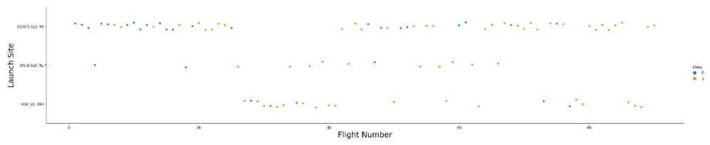
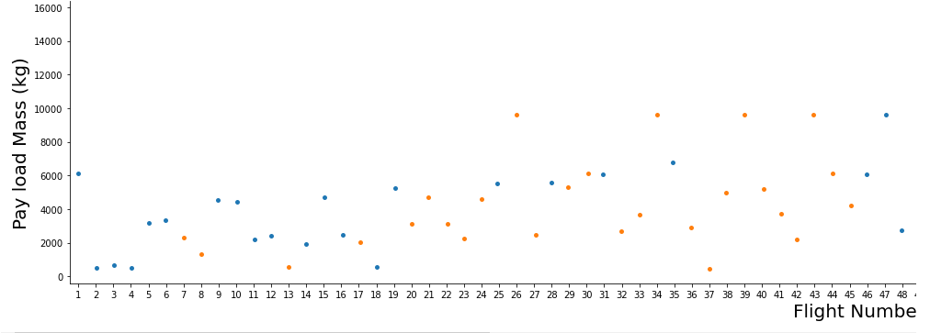
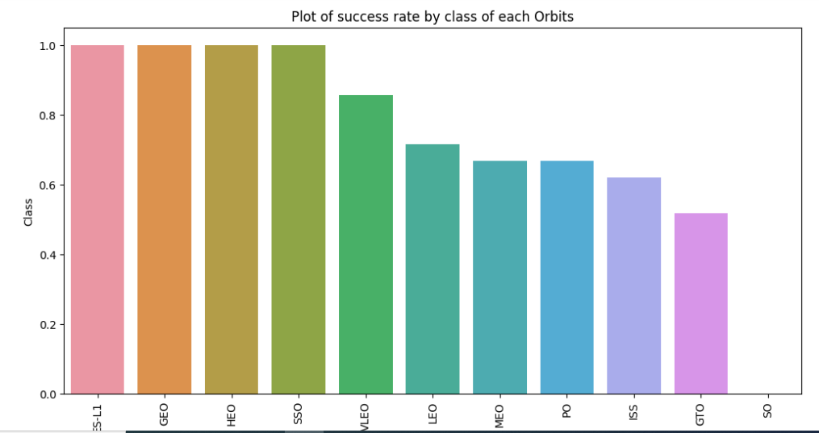
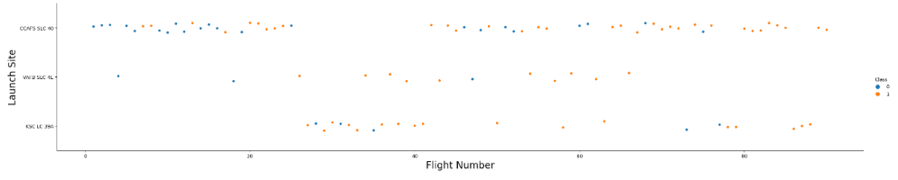
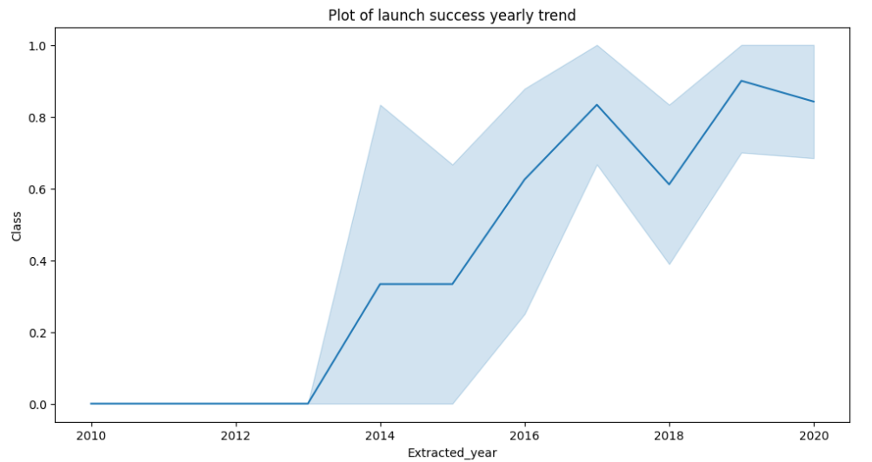
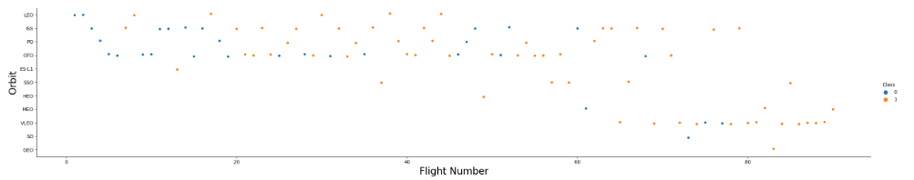
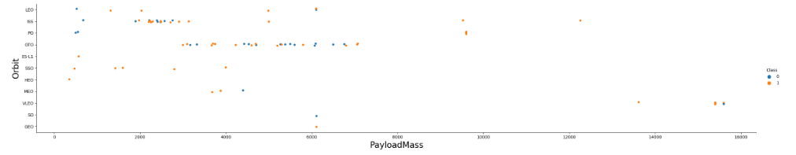
EDA with Data Visualization
https://github.com/Panacea020/Data-Science-Capstone-project-SpaceX/blob/main/EDA%20with%20Data%20Visualization%20spaceX.ipynb

Slide 12
EDA with SQL
SQL queries performed include
Displaying the names of the unique launch site in the space mission
Displaying top 5 records where launch sites begin with the string ‘KSC’
Displaying the total payload mass carried by booster version F9 V1.1
Listing the date where the successful landing outcome in drone ship was achieved.
Listing the name of Boosters which had success in ground and have payload mass greater than 4000 but less than 6000
Listing a total number of successful and failure mission outcomes
Listing of booster versions which have carried the maximum payload mass
Listing the record which will display the month names, successful landings outcomes in ground pad, booster versions, launch site for the months in 2018
Ranking the count of successful landing outcomes between the date 2010-06-04 and 2017-03-20 in descending order.
https://github.com/Panacea020/Data-Science-Capstone-project-SpaceX/blob/main/IBM-EDA%20with%20SQL.ipynb%20at%20main%20%C2%B7%20chuksoo_IBM-Data-Science-Capstone-SpaceX.html

Slide 13
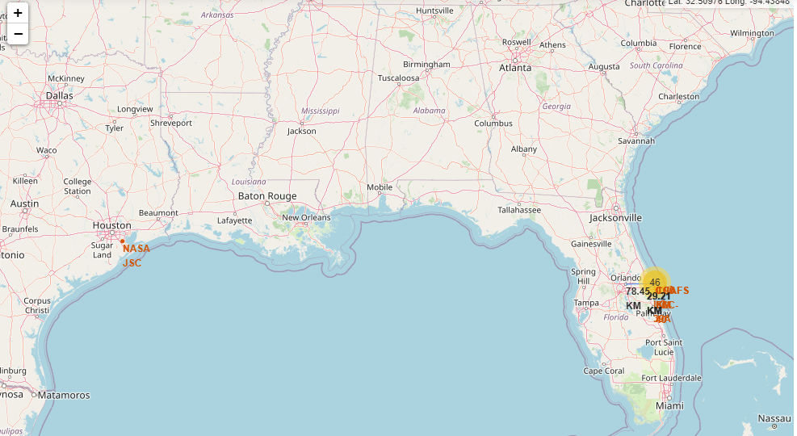
Interactive Map with Folium
Markers were added with aim to finding a optimal location to building a launch site.
https://github.com/Panacea020/Data-Science-Capstone-project-SpaceX/blob/main/INTERACTIVE%20FOLIUM%20MAP.ipynb

Slide 14
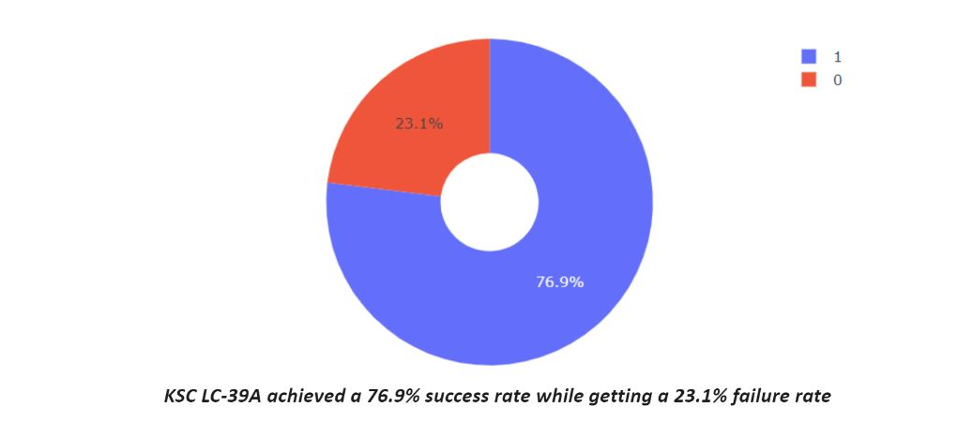
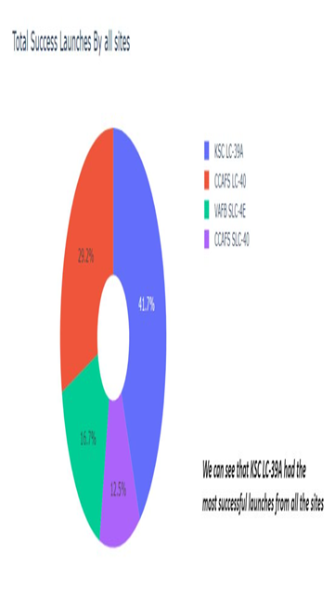
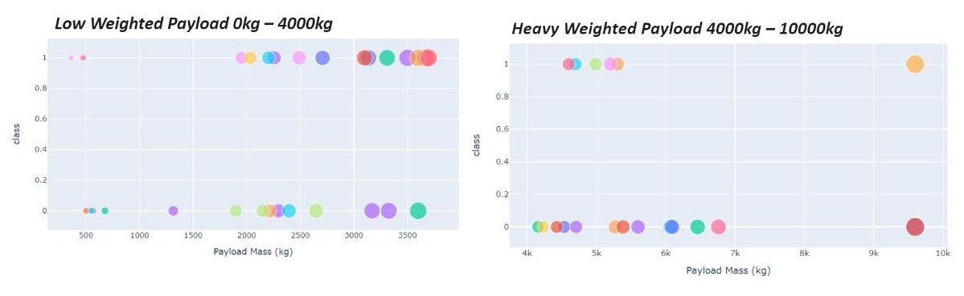
Build a Dashboard with Plotly Dash
https://github.com/Panacea020/Data-Science-Capstone-project-SpaceX/blob/main/SpaceX%20plotly.html

Slide 15
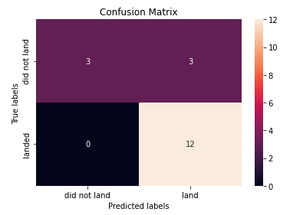
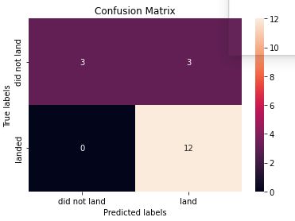
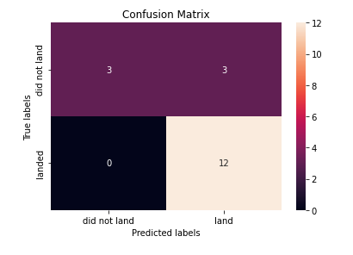
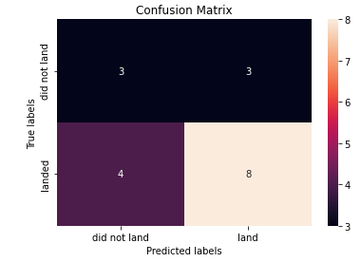
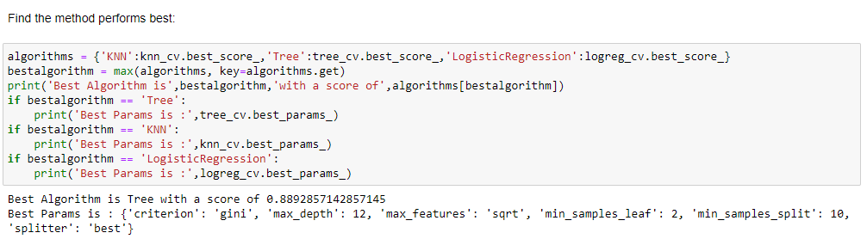
Predictive Analysis (Classification)
The SVM ,KNN and logistics regression produced the highest accuracy at 88.9%. SVM performs best in terms of area under curve at 0.95
https://github.com/Panacea020/Data-Science-Capstone-project-SpaceX/blob/main/Predictive%20Analysis%20ML.ipynb

Slide 16
Results
The SVM , KNN, and logistic Regression are the best in terms of prediction accuracy for this SpaceX dataset.
Low weighted payloads perform better than the heavier payloads.
The success rate for Space X launches is directly proportional time in years they will eventually perfect the launches.
KSC LC 39A had the successful Launches from the sites.
Orbit GEO, HEO, SSO ,ES L1 have the best Success rate

Slide 17

Section 2

Slide 18
Flight Number vs. Launch Site
Flight Number vs. Launch Site
Show the screenshot of the scatter plot with explanations
CCAFS 40 has a significantly higher launches than other sited

Slide 19
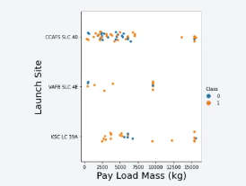
Payload vs. Launch Site
Payload vs. Launch Site
The majority of Pay loads with lower mass have been launched from CCAFS SLC40

Slide 20
Success Rate vs. Orbit Type
Show the screenshot of the scatter plot with explanations
The orbit Types of ES-L1, GEO, HEO, SSO are among the highest success rate

Slide 21
Flight Number vs. Orbit Type
Flight number vs. Orbit type
A trend can be observed of shifting to VLEO launches in recent years

Slide 22
Payload vs. Orbit Type
payload vs. orbit type
There is a strong correlation between ISS and Payload at the range around 2000, as well as between GTO and the range of 4000 – 8000

Slide 23
Launch Success Yearly Trend
The launch success rate has increased significantly since 2013 and has established since 2019, potentially due to advance in technology and the lessons learnt over the past years.

Slide 24
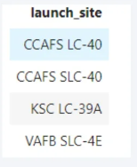
All Launch Site Names
%sql select distinct(LAUNCH_SITE) from SPACEXTBL

Slide 25
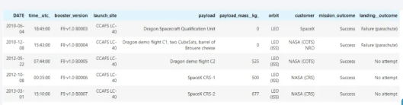
Launch Site Names Begin with 'CCA'
%sql select* from SPACETBL where LAUNCH_SITE like CCA% LIMIT 5

Slide 26
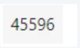
Total Payload Mass
%sql select sum(PAYLOAD_MASS_KG_) from SPACETBL where CUSTOMER = ‘NASA(CRS)’

Slide 27
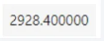
Average Payload Mass by F9 v1.1
%sql select avg(AVG_MASS_KG_) from SPACEXTBL where BOOSTER_VERSION = ‘F9 v1.1’

Slide 28
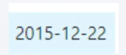
First Successful Ground Landing Date
%sql select min(DATE) from SPACEXTBL where Landing Outcome = ‘Success(ground pad)’

Slide 29
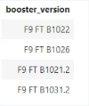
Successful Drone Ship Landing with Payload between 4000 and 6000
%sql select OOSTER_VERSION from SPACEXTBL where Landing Outcome = ‘Success (drone ship)’ and PAYLOAD_MASS_KG_>4000 and Payload_MASS_KG_<6000

Slide 30
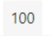
Total Number of Successful and Failure Mission Outcomes
%sql select count(MISSION_OUTCOME) from SPACEXTL where MISSION_OUTCOME = ‘Failure(in flight)’

Slide 31
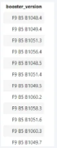
Boosters Carried Maximum Payload
%sql select BOOSTER_VERSION from SPACEXTBL where PAYLOAD_MASS_KG_ = (select max(PAYLOAD_MASS_KG_) from SPACEXTBL

Slide 32
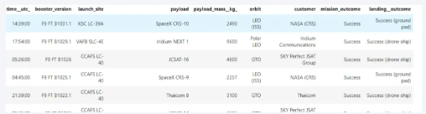
2015 Launch Records
%sql select ‘ from SPACEXTBL where Landing _Outcome like ‘Success%’ and (DATE between ‘2015-01-01’ and ‘2015-12-31’) order by date desc

Slide 33
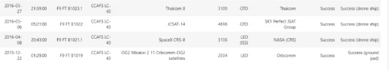
Rank Landing Outcomes Between 2010-06-04 and 2017-03-20
%sql select ‘ from SPACEXTBL where Landing _Outcome like ‘Success%’ and (DATE between ‘2010-06-04’ and ‘2017-03-20’) order by date desc

Slide 34

Section 3

Slide 35

ALL LAUNCH SITES MARKED ON THE MAP
Explain the important elements and findings on the screenshot

Slide 36
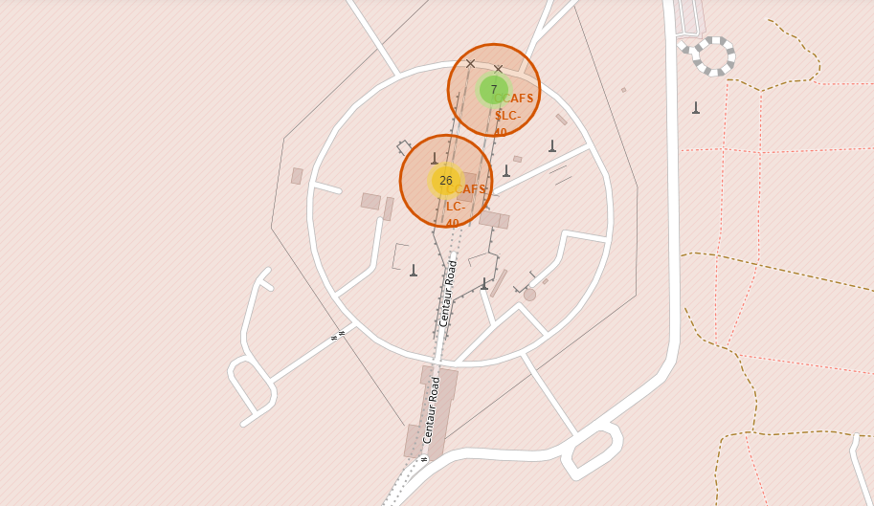
Success/failed launches for each site on the map

Slide 37
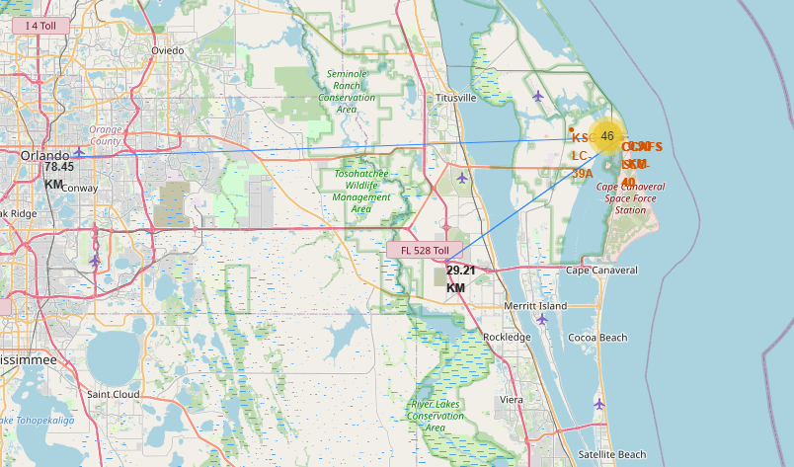
Distance between launch site and its proximities

Slide 38

Section 4

Slide 39

Total Success Launches by all sites

Slide 40
KSC LC-39 success rate
KSC LC-39 Achieved a 76.9% success rate while getting a 23.1% failure rate.

Slide 41
Payload vs Launch Outcome
We can see the success rate for low weighted payload is higher than the heavy weighted payloads

Slide 42

Section 5

Slide 43
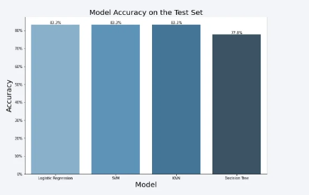
Classification Accuracy

Slide 44
Confusion Matrix

Slide 45
Conclusions
The SVM , KNN AND logistics regression models are the best in terms of prediction accuracy for this data set
Low weighted payloads perfom better than heavier payloads
KSC LC 39A had the most successful launches from all the sites
Orbit GEO ,HEO, SSO, ES L1 has the best success Rate.
The success rates for spaceX launches is directly proportional to time in years they will eventually perfect the launch.
…

Slide 46
Appendix
Include any relevant assets like Python code snippets, SQL queries, charts, Notebook outputs, or data sets that you may have created during this project

Slide 47


